Slide 1

AparateDeEtichetat.ro
Final Project - Bazele Software Testing
Septembrie 2020 | Olivia Vasile

Slide 2

Table of content
Website Presentation
Testing Objectives
The Approach & Strategy
What Hasn’t Been Approached?
Requirements Breakdown
Environment & Tools
Test Design
Test Metrics
Identified Defects
Conclusions
Lessons Learned
Bibliography
2

Slide 3
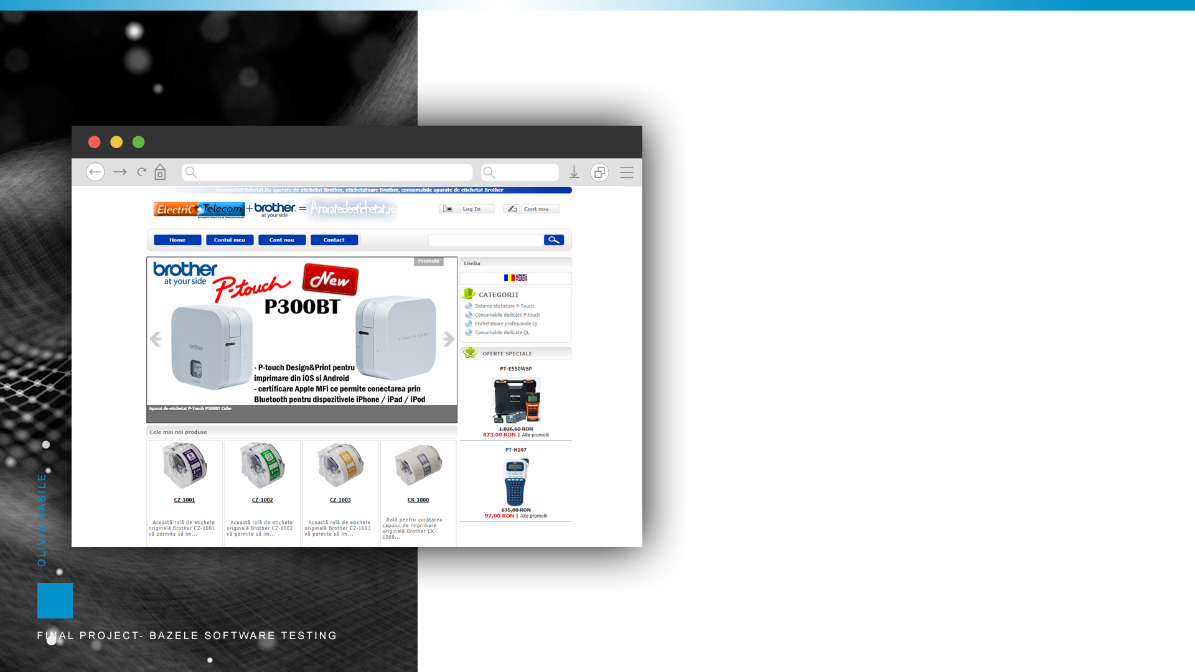
Website Presentation
http://www.aparatedeetichetat.ro/
available since 2009
the commercial objective: distribution of labeling system, label printer applicator & supply product
954th place in the general ranking trafic.ro
no more than 10 visitors/ week
not secured
only Electronic Fund Transfer& cash on delivery accepted as payment method
for customer support is using tawk.to service
3

Slide 4

Testing Objectives
To determine (in proportion of minimum 10%) how well the website fulfills basic requirements and standards for e-commerce features, specially registration, login, advanced search, shopping cart management and checkout.
4

Slide 5
The approach & strategy
The right way of doing it:
requirements analysis
test planning
test analysis & design (smoke test’s priority)
test execution
test reporting
test closure
Obstacles:
lake of customer requirements
poor previous experience
Obstacle made things harder:
it was hard trying to design covering and ergonomics test cases with additional efficient test data
it was hard to track steps on designing
functional vs non-functional
bug severity
it was almost impossible to test other features with a login blocker bug
it was frustrating to missed the established deadline
5

Slide 6

How I Managed?
XMind Mapping for standard flow
Exploratory Testing combined with Feature Testing– for requirements, test analysis and design, test execution
test design and execution in the same time for
reassembling test suites when building the Test Report
better steps tracking
keep moving the deadline
6
boundary value analysis

Slide 7

What I Didn’t Do?
Browser, OS, device Compatibility (only mobile design responsiveness was verified)
Session expiration management (only shopping cart session storage was verified)
Internationalization e.g. language support
Performance ( JMeter)
Negative test on Checkout and Customer Account
UI & Usability testing=> event handlers and interface testing, breadcrumbs, images
Security (only elementary, “black box security testing” was used)
Server side testing & and all the approaches about I don’t know I didn’t do
7

Slide 8
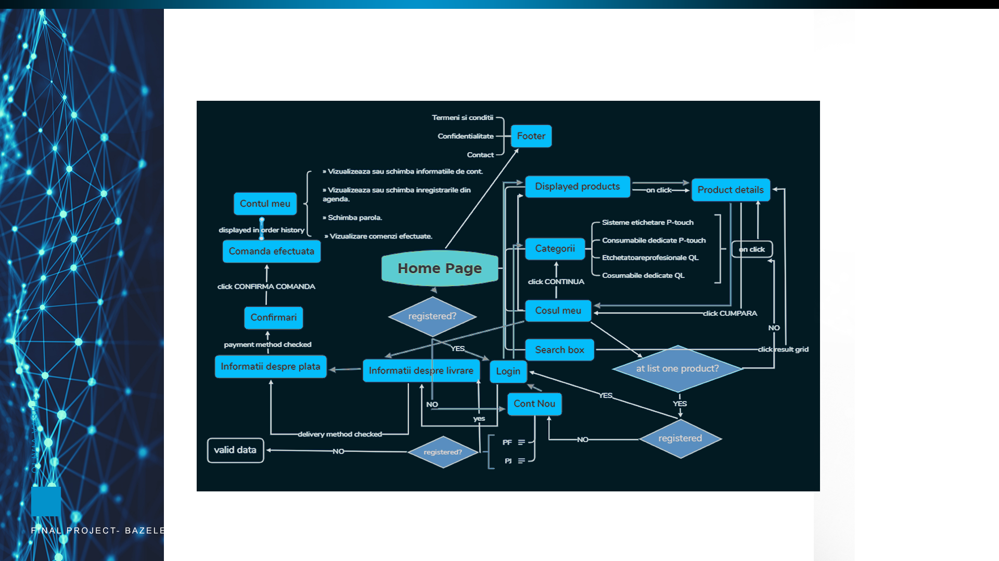
Requirements breakdown
8

Slide 9

Environment & Tools
Test Environment
Test Device: laptop Lenovo
Intel (R) Core (TM) i5-4288U CPU @2.60 GHz
RAM: 8.00 GB
64bit OS x-64 based processor
Operating System: Windows 10 Pro
Browser: Chrome
Test Tools
TestLink
Mantis bug tracker
Screen Recorder Pro
Snip & Sketch
XMind: Mind Mapping Software
Responsinator
https://2gdpr.com/
9

Slide 10

Test Analysis & Design
When testing design we followed 9 main features
Feature | Number of test cases
Registration | 35
Login | 15
Customer Account | 4
Search | 21
Shopping Cart | 19
Checkout | 8
Site Navigation | 3
Mobile responsiveness | 1
Content Analysis | 4
Total | 110
10

Slide 11
Testing Types
11

Slide 12
Test metrics
12

Slide 13

Identified Defects
The blockers
The critical ones
The normal ones
Login | 28074 | [LogIn] User is not able to login using valid & registered credentials
Checkout | 28360 | [Checkout] Unlogged user is not able to login in order to proceed checkout
Content Analysis | 28111 | [Localisation] The website content is not GDPR compliant
Registration | 27978 | [Security] User is not able to send encrypted sensitive data to server
Search | 27964 | [SearchBox] User is not able to receive all the products having in title relevant keyword search
Mobile responsiveness | 28349 | [Compatibility] Lake of responsiveness to mobile devices
13
Shopping cart | 28271 | [CosulMeu] Missing restriction for proceeding checkout in case of number of items exceeding the stock

Slide 14

Severity by feature
Severity by feature
14

Slide 15

Conclusions
This testing session revealed major defects in terms of e-commerce standards.
A website with “crashed login” cannot coverts the visitors into paying customers, so the blocker login should be fixed immediately.
A website needs to be secure. Exposing sensitive data in non-encrypted format means a major risk for the customers and as a consequence an automatically traffic decreasing.
A website should work not just on desktop, but on mobile devices too. Nowadays the non-responsiveness is an issue and generates major traffic decreasing.
Missing cookies policy and a content that doesn’t comply with GDPR regulations is also a critical problem in terms of customer’s trust and penal law.
If the advanced search appears like an available feature, then it should work properly, otherwise is just a tool for increasing frustration.
Missing validation for name and address input it may be also a problem not just for data integrity, but also for wrong or not- shipped orders.
15

Slide 16
Lessons Learned
Never ever:
accept a build in case of failed smoke test
skip documenting a bug within exploratory testing
skip planning & structuring the testing session based on main features
minimise the effort of designing test case & test data
ignore the unexpected within the planning
16

Slide 17

Grateful For
https://www.softwaretestinghelp.com/ecommerce-testing/
https://www.softwaretestinghelp.com/sample-test-cases-testing-web-desktop-applications/
https://www.guru99.com/testing-e-commerce-applications.html
https://devqa.io/testing-e-commerce-websites/
https://www.clariontech.com/blog/20-scenarios-for-testing-login-pages-and-search-functionality-on-websites
17

